Slide 1
LECTURE 01 • WEEK 06
Design and Analysis of Algorithms
Algorithms & Programming Review
From C++ basics to thinking like an algorithm designer
International Software Engineering Students
Dr Hussain
Dr Hussain | Zhengzhou University | Software Engineering
01

Slide 2
LECTURE 01 • WEEK 06
Meet Your Instructor
Dr Hussain
Assistant Professor
School of Computer Science and Artificial Intelligence
Zhengzhou University, China
- PhD in Software Engineering, Zhengzhou University (2023)
- Former Postdoctoral Research Fellow, Tsinghua University, Shenzhen, China (2024–2026)
- Research Areas: Artificial Intelligence, Machine Learning, Deep Learning, and Biomedical AI
- Teaching Experience: Over 14 years in Computer Science and Software Engineering
- Tsinghua University Ranking: #14 worldwide in the QS World University Rankings 2027.
Dr Hussain | Zhengzhou University | Software Engineering
01

Slide 3
WEEK 06 • FOUNDATIONS
Today’s learning goals
1
Describe an algorithm in everyday language.
2
Review C++ variables, loops, arrays and decisions.
3
Write simple pseudocode and trace a program.
4
Recognize why running time and memory matter.
Dr Hussain | Zhengzhou University | Software Engineering
02

Slide 4
WEEK 06 • FOUNDATIONS
Where do we use algorithms?
Maps
Shopping
Find a short route.
Sort products by price.
Messaging
Video apps
Search for a contact.
Recommend or rank content.
Dr Hussain | Zhengzhou University | Software Engineering
03

Slide 5
WEEK 06 • FOUNDATIONS
Algorithm = clear steps
Input
→
Process
→
Output
Try to explain each step in your own words.
Dr Hussain | Zhengzhou University | Software Engineering
04

Slide 6
WEEK 06 • FOUNDATIONS
What makes an algorithm useful?
1
Instructions must be clear.
2
The steps must eventually stop.
3
It should produce the intended result.
4
It should work for the allowed inputs.
Dr Hussain | Zhengzhou University | Software Engineering
05

Slide 7
CLASS QUIZ • DISCUSS BEFORE REVEALING
Quick Check
Which example is an algorithm?
A. “Make it better”
B. A finite recipe with ordered steps
C. “Try something”
D. An instruction without an ending
Dr Hussain | Zhengzhou University | Software Engineering
06

Slide 8
WEEK 06 • FOUNDATIONS
Example: Make a cup of tea
Prepare
→
Heat water
→
Steep tea
→
Serve
Dr Hussain | Zhengzhou University | Software Engineering
07

Slide 9
WEEK 06 • FOUNDATIONS
A programmer’s problem-solving method
Understand
→
Plan
→
Code
→
Test
→
Improve
Dr Hussain | Zhengzhou University | Software Engineering
08

Slide 10
WEEK 06 • FOUNDATIONS
Input, process, output
Input
Process
Output
Problem: Write an algorithm to search for a person's name in a phone's contact list.
Algorithm:
Start.
Open the phone's contact list.
Enter the name you want to search for.
Check each contact one by one.
If the name matches, display the contact details and stop.
If no match is found after checking all contacts, display "Contact not found."
End.
Dr Hussain | Zhengzhou University | Software Engineering
09

Slide 11
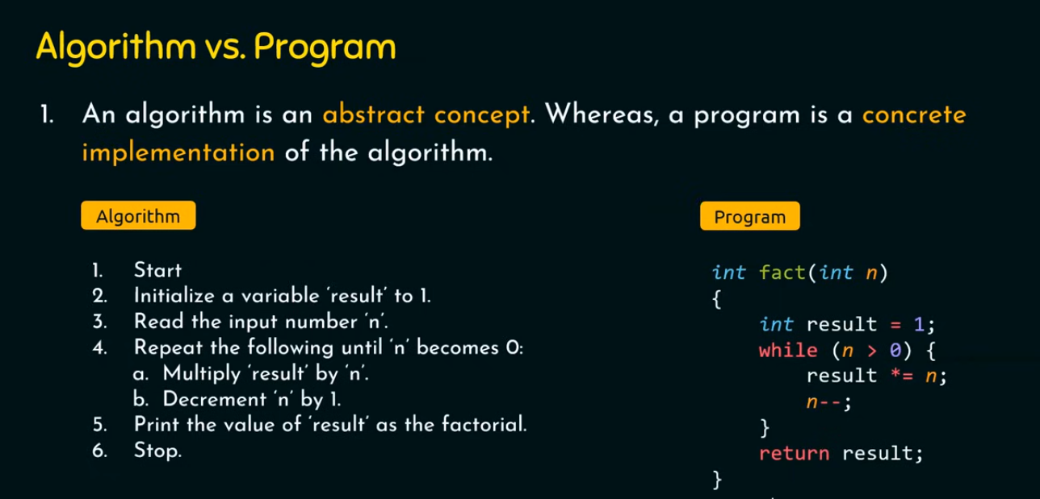
C++ REVIEW • READ, TRACE, EXPLAIN
C++ refresher: variables
int a = 5;
int b = 7;
int sum = a + b;
cout << sum;
THINK ABOUT
What values are stored?
What is printed?
Dr Hussain | Zhengzhou University | Software Engineering
10

Slide 12
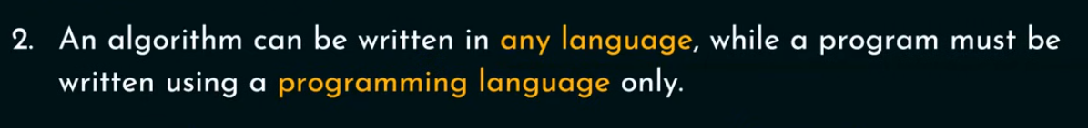
C++ REVIEW • READ, TRACE, EXPLAIN
C++ refresher: variables
int a = 5;
int b = 7;
int sum = a + b;
cout << sum;
THINK ABOUT
What values are stored?
What is printed?
Dr Hussain | Zhengzhou University | Software Engineering
10

Slide 13
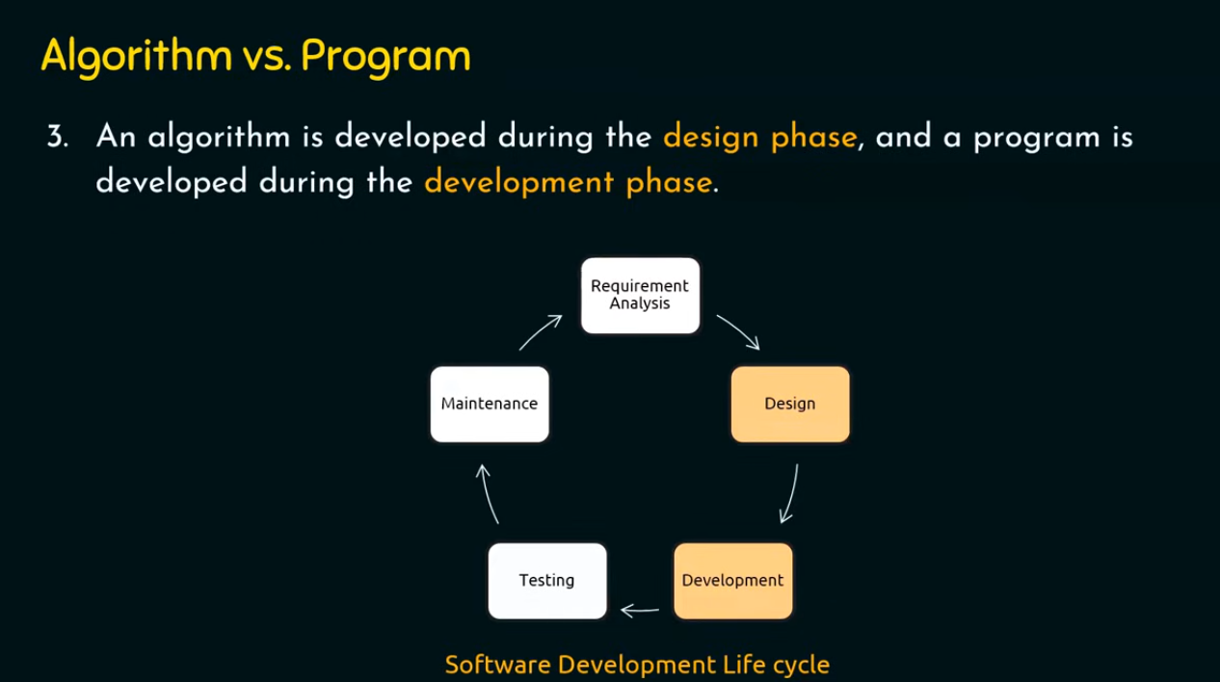
C++ REVIEW • READ, TRACE, EXPLAIN
C++ refresher: variables
int a = 5;
int b = 7;
int sum = a + b;
cout << sum;
THINK ABOUT
What values are stored?
What is printed?
Dr Hussain | Zhengzhou University | Software Engineering
10

Slide 14
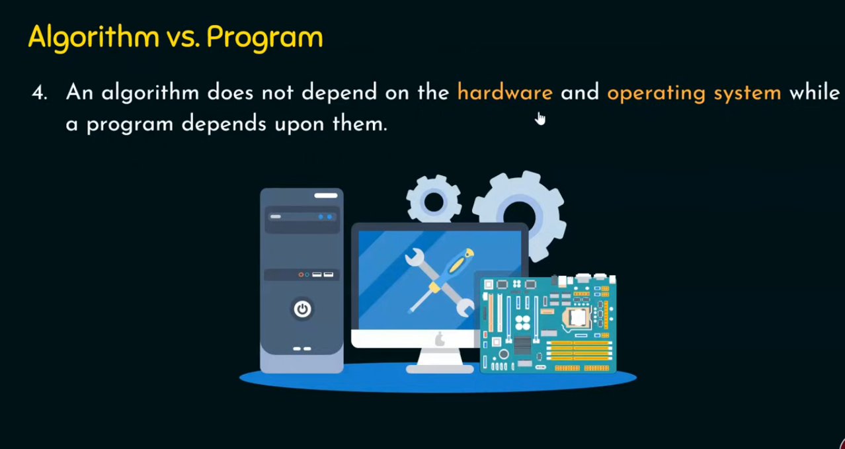
C++ REVIEW • READ, TRACE, EXPLAIN
C++ refresher: variables
int a = 5;
int b = 7;
int sum = a + b;
cout << sum;
THINK ABOUT
What values are stored?
What is printed?
Dr Hussain | Zhengzhou University | Software Engineering
10

Slide 15
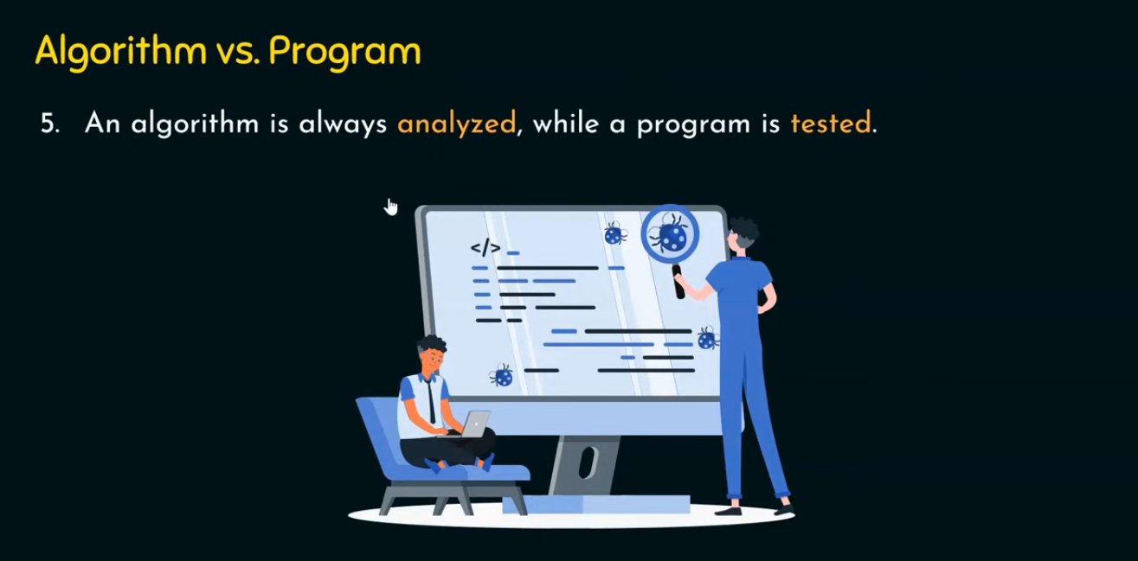
C++ REVIEW • READ, TRACE, EXPLAIN
C++ refresher: variables
int a = 5;
int b = 7;
int sum = a + b;
cout << sum;
THINK ABOUT
What values are stored?
What is printed?
Dr Hussain | Zhengzhou University | Software Engineering
10

Slide 16
CLASS QUIZ • DISCUSS BEFORE REVEALING
Quick Check
What does the C++ code print? int x=4; x=x+3; cout<<x;
A. 4
B. 3
C. 7
D. 43
Dr Hussain | Zhengzhou University | Software Engineering
11

Slide 17
C++ REVIEW • READ, TRACE, EXPLAIN
C++ refresher: if / else
int score = 65;
if (score >= 60) {
cout << "Pass";
} else {
cout << "Try again";
}
THINK ABOUT
Predict the output.
What changes if score becomes 50?
Dr Hussain | Zhengzhou University | Software Engineering
12

Slide 18
C++ REVIEW • READ, TRACE, EXPLAIN
C++ refresher: for loop
for (int i=0; i<4; i++) {
cout << i << " ";
}
THINK ABOUT
Trace i each time.
How many repetitions?
Dr Hussain | Zhengzhou University | Software Engineering
13

Slide 19
C++ REVIEW • READ, TRACE, EXPLAIN
C++ refresher: while loop
int i = 1;
while (i <= 3) {
cout << i << " ";
i++;
}
THINK ABOUT
Which condition ends the loop?
What happens without i++?
Dr Hussain | Zhengzhou University | Software Engineering
14

Slide 20
WEEK 06 • FOUNDATIONS
Arrays: values and indices
8
3
11
6
2
0
1
2
3
4
Index (starts at 0)
a[0] = 8, a[2] = 11, and a[4] = 2.
Dr Hussain | Zhengzhou University | Software Engineering
15

Slide 21
CLASS QUIZ • DISCUSS BEFORE REVEALING
Quick Check
For int a[]={8,3,11,6,2}; what is a[2]?
A. 3
B. 11
C. 6
D. 2
Dr Hussain | Zhengzhou University | Software Engineering
16

Slide 22
C++ REVIEW • READ, TRACE, EXPLAIN
Read an array with a loop
int a[] = {8, 3, 11};
for (int i=0; i<3; i++) {
cout << a[i] << " ";
}
THINK ABOUT
What does the loop print?
Which index is visited last?
Dr Hussain | Zhengzhou University | Software Engineering
17

Slide 23
C++ REVIEW • READ, TRACE, EXPLAIN
Find the sum of an array
int a[] = {2, 4, 6};
int total = 0;
for (int i=0; i<3; i++)
total += a[i];
cout << total;
THINK ABOUT
Trace total after each iteration.
Dr Hussain | Zhengzhou University | Software Engineering
18

Slide 24
WEEK 06 • FOUNDATIONS
Tracing a sum step by step
2
4
6
0
1
2
Index (starts at 0)
Running totals: 0 → 2 → 6 → 12
Dr Hussain | Zhengzhou University | Software Engineering
19

Slide 25
WEEK 06 • FOUNDATIONS
Trace tables make code easier
Step 1
Step 2
Step 3
i = 0; total = 2
i = 1; total = 6
i = 2; total = 12
Dr Hussain | Zhengzhou University | Software Engineering
20

Slide 26
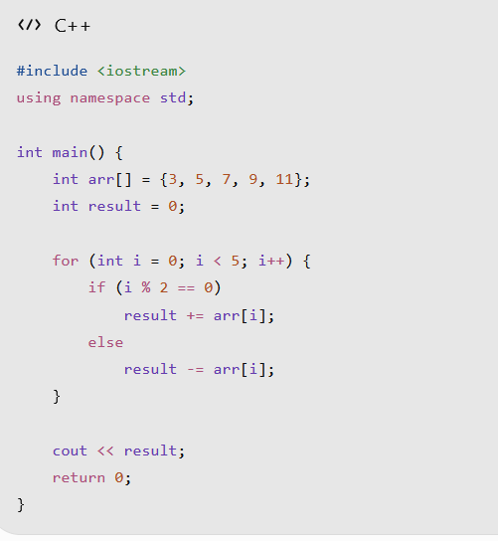
CLASS QUIZ • DISCUSS BEFORE REVEALING
Quick Check
#include <iostream>
using namespace std;
int main() {
int arr[] = {3, 5, 7, 9, 11};
int result = 0;
for (int i = 0; i < 5; i++) {
if (i % 2 == 0)
result += arr[i];
else
result -= arr[i];
}
cout << result;
return 0;
}
A. 7
B. 11
C. 15
D. 25
Dr Hussain | Zhengzhou University | Software Engineering
21

Slide 27
WEEK 06 • FOUNDATIONS
What is pseudocode?
1
Plain-language instructions for a solution.
2
Independent of C++ or Python syntax.
3
Easy to read, explain and revise.
4
Useful before writing the actual program.
Dr Hussain | Zhengzhou University | Software Engineering
22

Slide 28
WEEK 06 • FOUNDATIONS
Pseudocode: find the larger number
Read a,b
→
Compare a,b
→
Choose larger
→
Print result
Try to explain each step in your own words.
Dr Hussain | Zhengzhou University | Software Engineering
23

Slide 29
C++ REVIEW • READ, TRACE, EXPLAIN
C++: maximum of two numbers
int a = 9, b = 14;
if (a > b) cout << a;
else cout << b;
THINK ABOUT
Write pseudocode for this program.
What is the output?
Dr Hussain | Zhengzhou University | Software Engineering
24

Slide 30
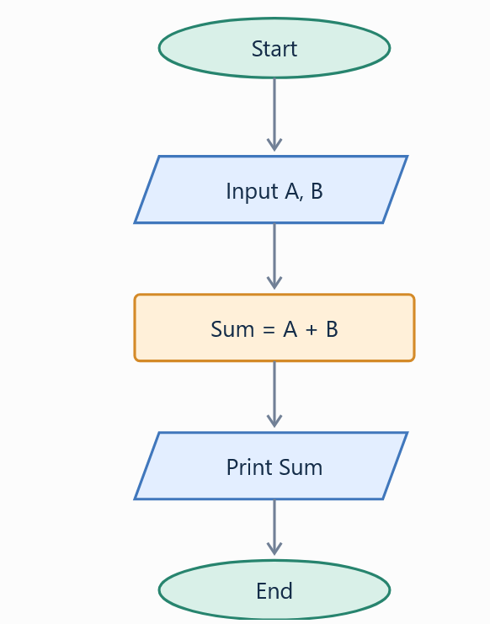
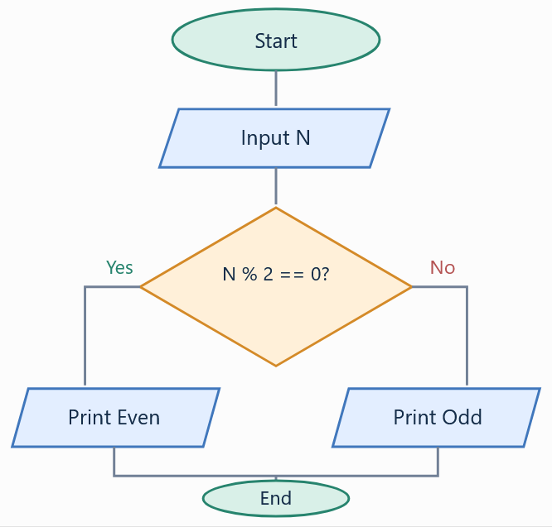
WEEK 06 • FOUNDATIONS
Flowchart symbols
Parallelogram
Oval
Input / Output
Start / End
Rectangle
Diamond
Process
Decision
Dr Hussain | Zhengzhou University | Software Engineering
25

Slide 31
CLASS QUIZ • DISCUSS BEFORE REVEALING
Quick Check
Which flowchart shape represents a decision?
A. Rectangle
B. Diamond
C. Oval
D. Arrow
Dr Hussain | Zhengzhou University | Software Engineering
26

